Slide 1
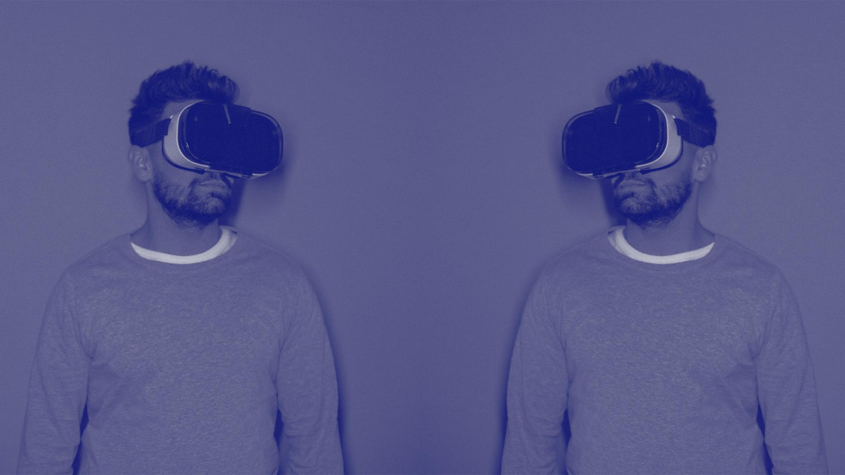


Computer Vision - 4th Computer & Systems (FEHU)
Supervisor: Dr.Motasem Elshourbagy
Smart Face Identifier & Styler

Slide 2

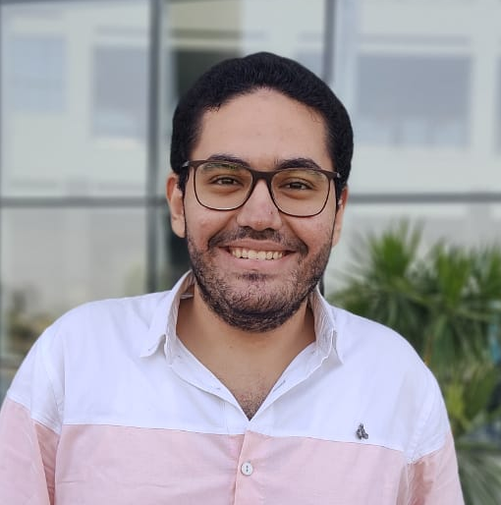
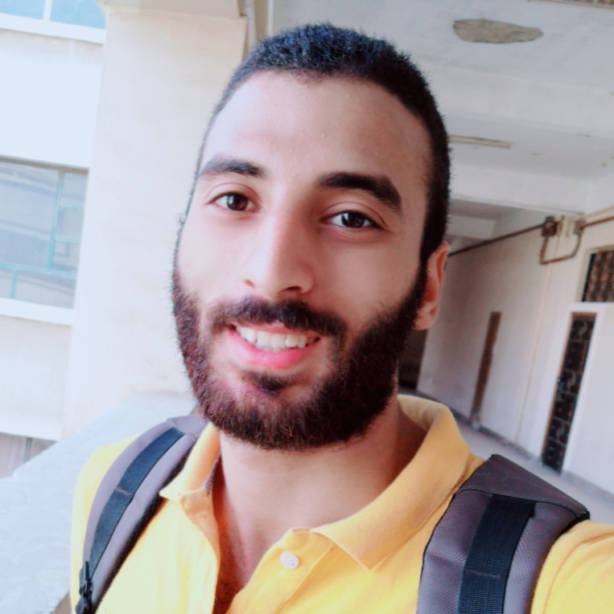
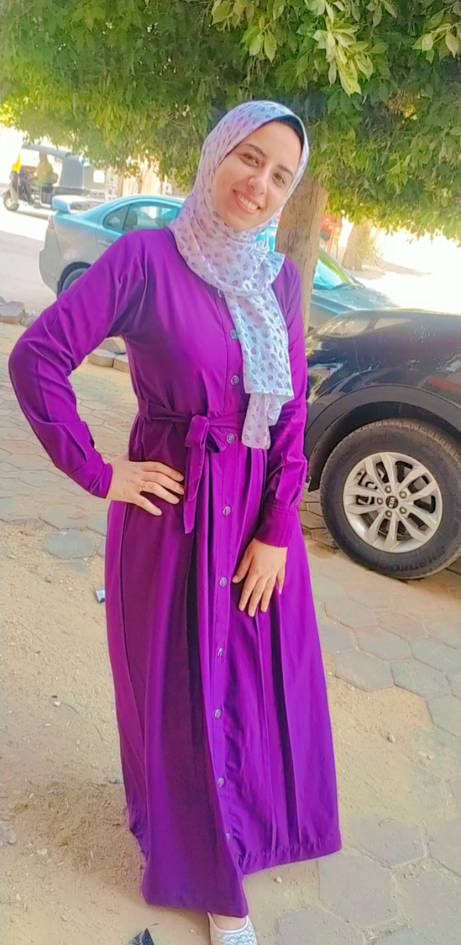
Our Team:
Noor El Deen Magdy
Hady Mohamed
Ali Fathy
Rania Mostafa

Slide 3
Table of Contents: Smart Face Identifier & Styler
01.
02.
03.
04.
05.
06.
Project Environment
Project Idea
Face Detection
People Identifier
Image Segmentation
Screen Painter

Slide 4
Table of Contents: Smart Face Identifier & Styler
07.
08.
09.
Style Transfer
Capture and save output.
Use Case Diagram

Slide 5




Project Idea and Environment:
Project Environment

Slide 6
Project Idea and Environment:
The Project environment can be summarized into 3 parts:
1- Main programming language. | Project as whole was written in Python.
2- Logic. | Project logic is mainly based on OpenCV library in Python.
3- GUI. | Project GUI was made with Kivy framework in Python.

Slide 7

Project Idea and Environment:
Project Idea
Notes:
احا

Slide 8
Project Idea and Environment:
The Project mainly can do:
0- Open Camera to Capture Stream and Overall Idea. | (Once the app is launched) | ✅
1- Detect Human Face(s). | (Function) | ✅
2- Identify People. | (Uses Faces Folder) | ✅
3- Update Faces. | (Update Faces Folder) | ✅
4- Apply Image Edge Detection and Segmentation filter. | (Function) | ✅
5- Paint on Screen. | (Function) | ✅

Slide 9
Project Idea and Environment:
The Project mainly can do:
6- Adding Style Transfer. | (Function) | ✅
7- Capture and Save Camera Output. | (To Gallery Folder) | ✅

Slide 10
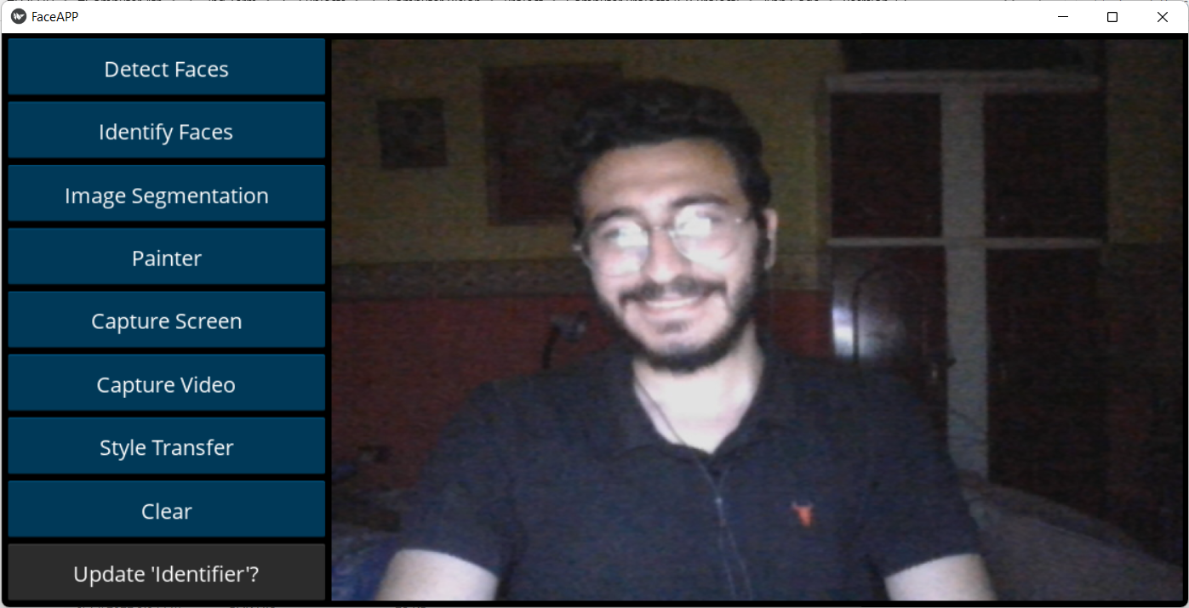
Start Screen // Project Idea

Slide 11

Apply "Detect Faces" Screen // Project Idea

Slide 12
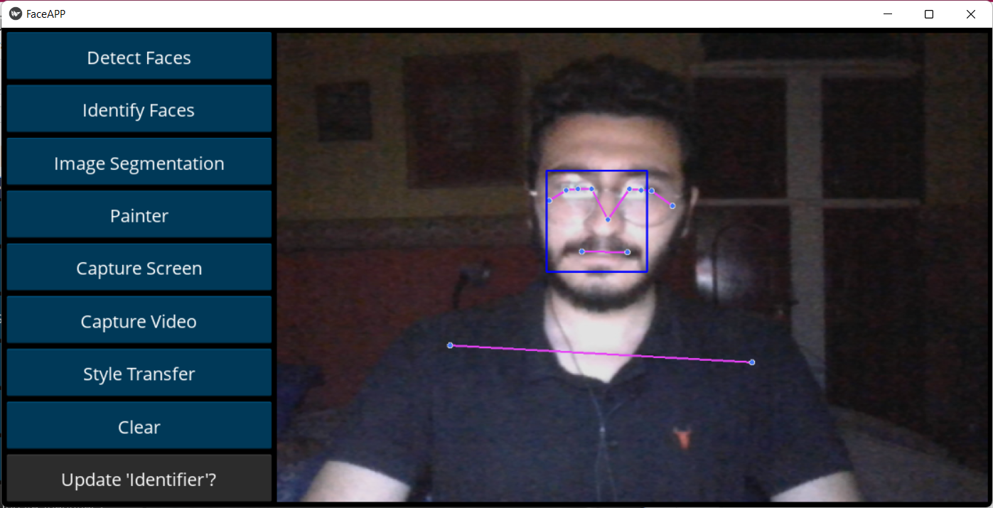
Apply "Detect Faces" Screen // Project Idea

Slide 13
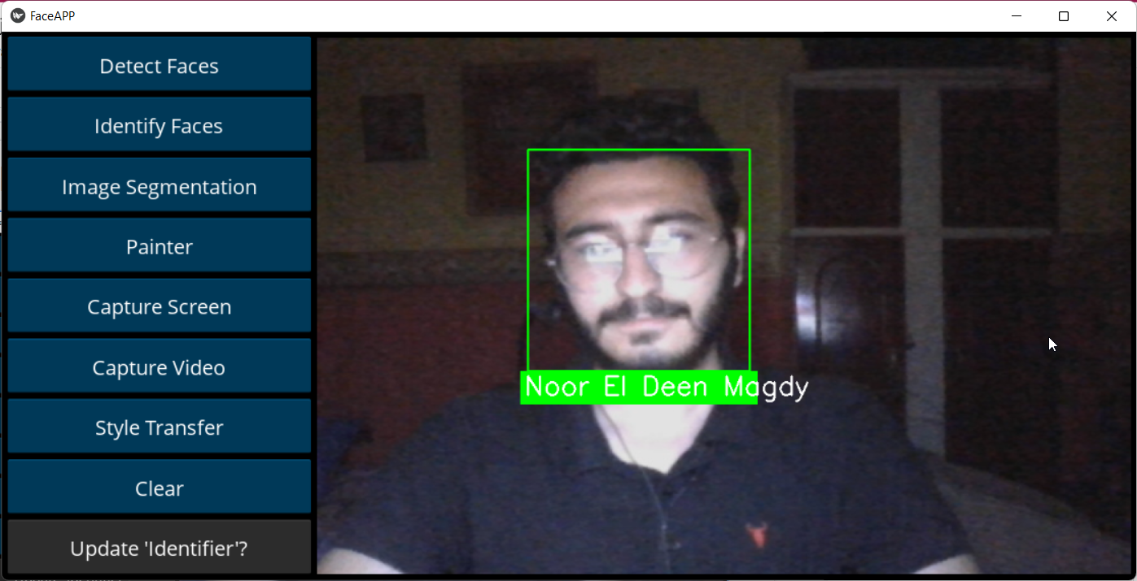
Apply "Identify Faces" Screen // Project Idea

Slide 14
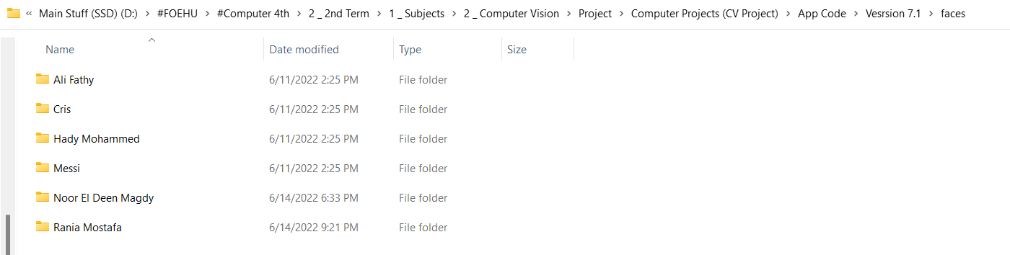
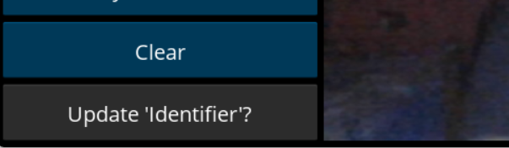
Apply "Update Identifier" Screen // Project Idea

Slide 15
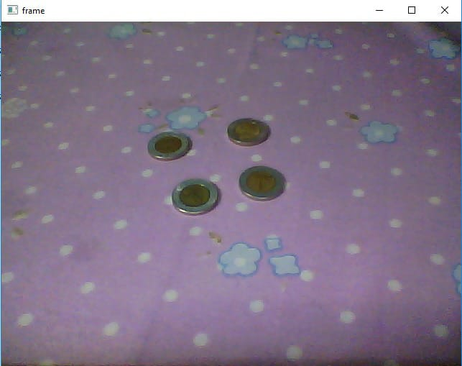
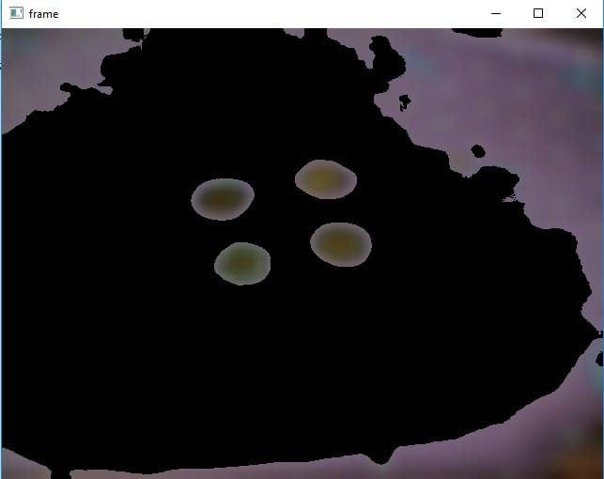
Apply "Image Segmentation" Screen // Project Idea

Slide 16
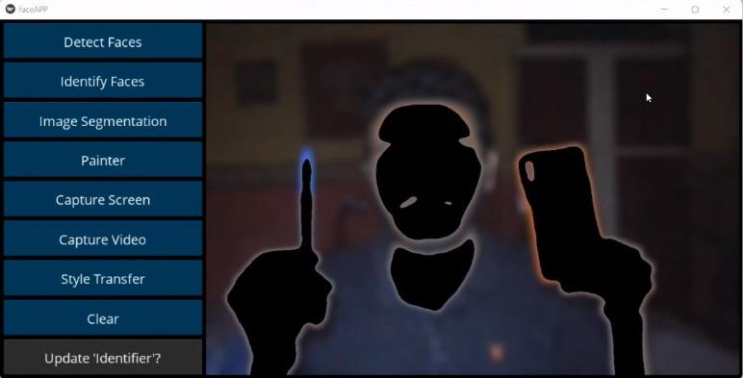
Apply "Image Segmentation" Screen // Project Idea

Slide 17
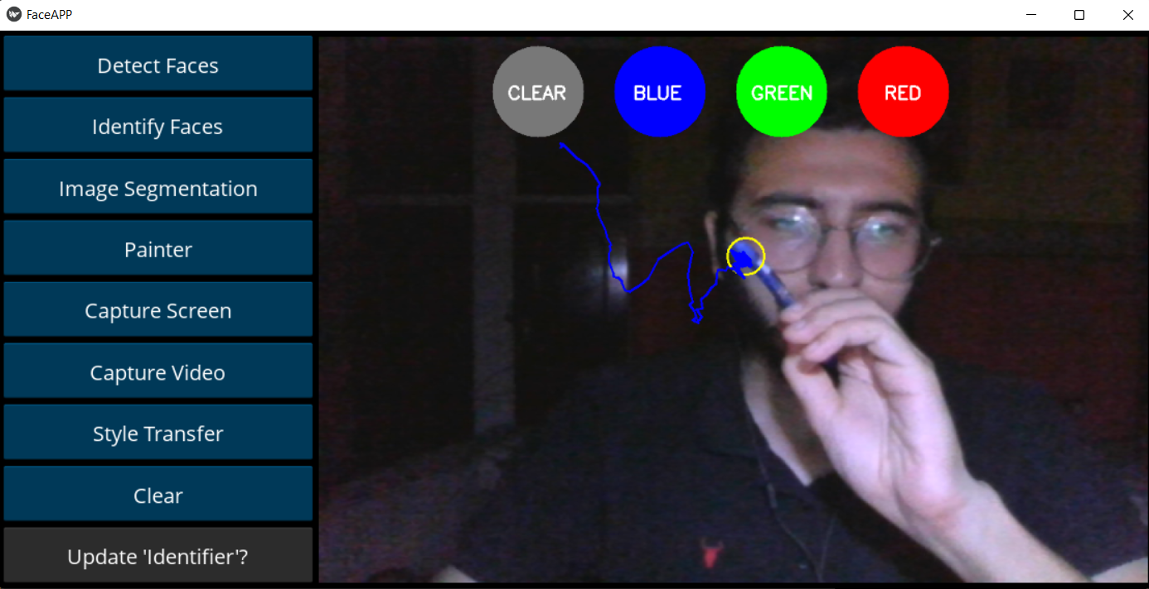
Apply "Painter" Screen // Project Idea

Slide 18
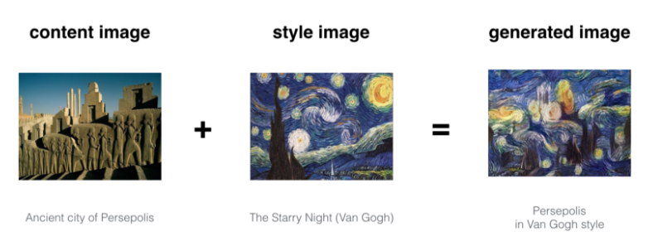
Apply "Style Transfer" Screen // Project Idea

Slide 19

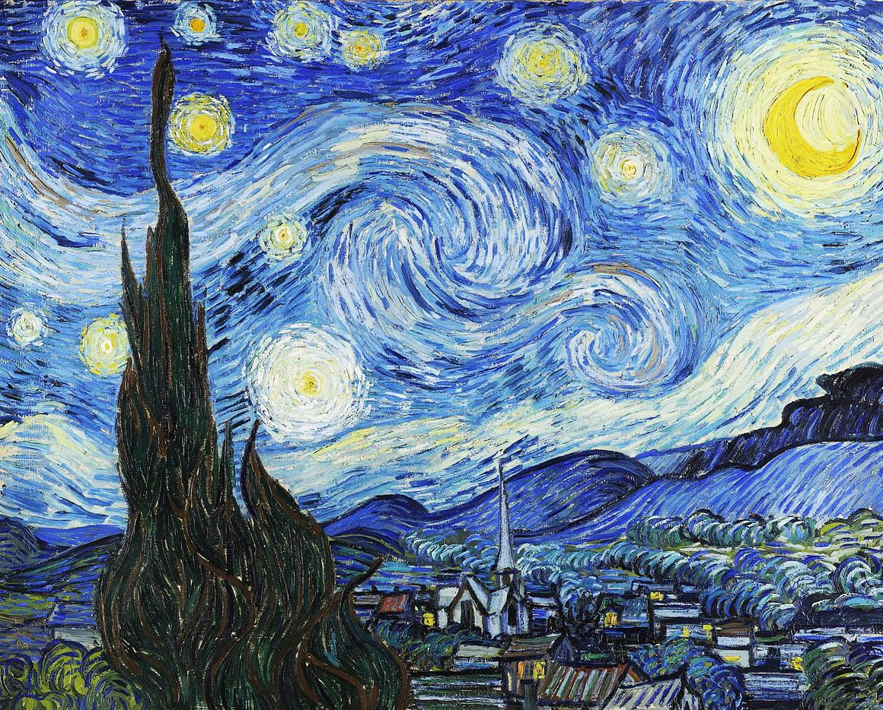
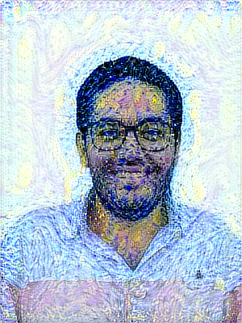
Apply "Style Transfer" Screen // Project Idea
+
=

Slide 20
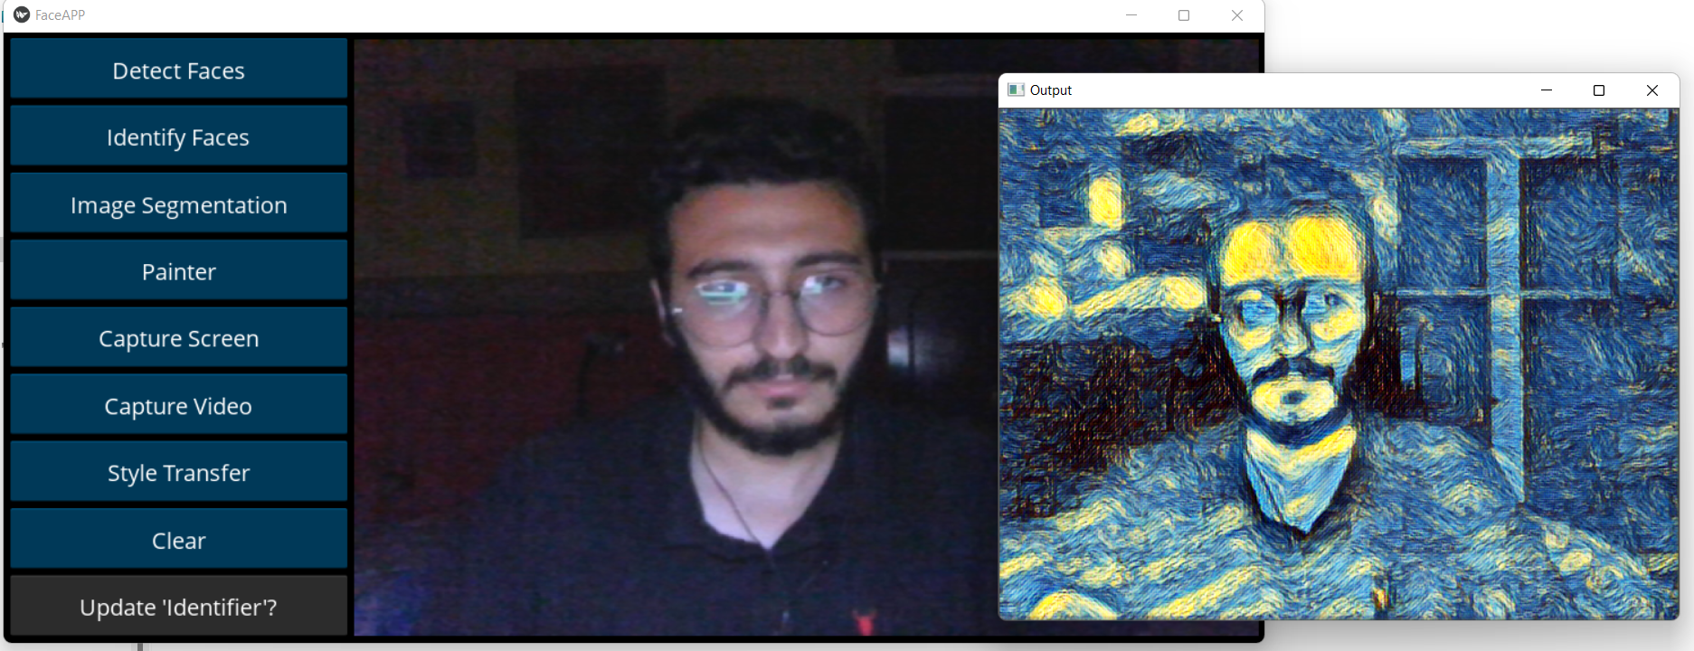
Apply "Style Transfer" Screen // Project Idea

Slide 21
Project Environment:
Notes:
1- Clear button just clear the screen from any applied operation
2- Capture button as mentioned before just capture camera stream and save it to gallery.
3- Update 'Identifier' button mentioned before just update the Faces Database that contains the faces of people should Identifier know.

Slide 22

Use-Case Diagram: Smart Face Identifier & Styler
Use-Case Diagram

Slide 23
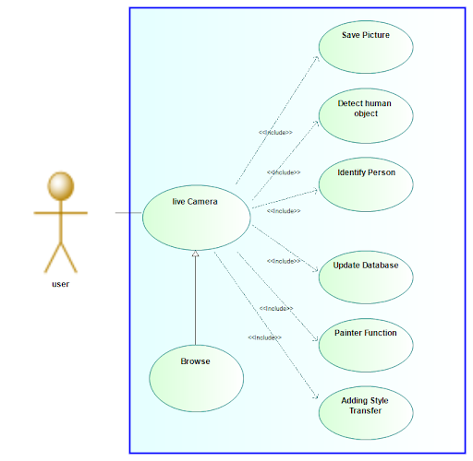

Use Case Diagram

Slide 24

Thanks! // Smart Face Identifier & Styler
THANKS!

